Slide 1
Unit 5 Overview
In this unit, you will be given an opportunity to apply information presented in the previous units.
You will be given a scenario involving flooding and you will be asked to select which NIMS Management Characteristics are demonstrated throughout the scenario.
By the end of this unit, you should be able to:
Identify how the National Incident Management System (NIMS) Management Characteristics apply in specific roles.
Identify how the National Incident Management System (NIMS) Management Characteristics apply in specific situations.

Slide 2
Emerald City Flood Scenario
Activity Purpose: To reinforce participants' understanding of NIMS Management Characteristics.
Instructions:
Working in groups, review the scenario presented in your Student Manual.
Use what you have learned in the course to answer the questions. Write your answers on chart paper.
Select a spokesperson and be prepared to discuss your answers to the questions.
Time: 10 minutes
Scenario: It has been raining heavily for the past seven days in Emerald City. The Emerald City and Liberty County Emergency Management offices are preparing for a response to a possible flood situation. Residents are starting to ask questions about the rising river and lake levels, and are wondering if they will need to leave their homes.

Slide 3
Emerald City Flood Scenario: Update 1
Instructions:
Working in groups, review the scenario presented in your Student Manual.
Use what you have learned in the course to answer the questions. Write your answers on chart paper.
Select a spokesperson and be prepared to discuss your answers to the questions.
Time: 10 minutes
Scenario Update 1:
Raining has continued for three more days and the flooding is expected to reach its highest point today. The flooding has caused residents to evacuate their homes in anticipation of rising floodwaters. Basement flooding to the first-floor level is anticipated.
The local Nursing Home is assessing the situation to determine if an evacuation of residents is necessary.

Slide 4
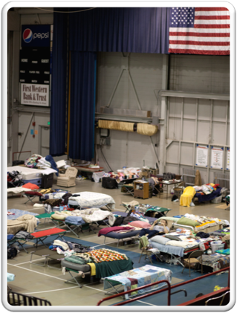
Emerald City Flood Scenario: Update 1 (Continued)
The Liaison Officer, with the support of the Public Information Officer, is in contact with business owners to determine if any of their stored chemicals will be affected by the flooding, causing possible contamination downstream.
Based upon previous floods, it is a high priority to establish shelters for evacuees early on. The Emergency Operation Plan pre-identified the following shelters: Lawrence College Auditorium and Lafayette Middle School.
Due to the complexity of the incident, the Incident Commander has expanded the Operations Section to include an Evacuation Group. The Evacuation Group Supervisor immediately contacts the Lawrence College President and the Lafayette Middle School Principal to begin the process of establishing shelters in those facilities.

Slide 5
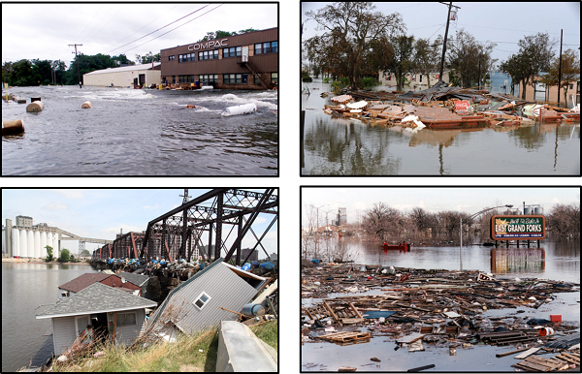
Emerald City Flood Scenario: Update 2
Instructions:
Working in groups, review the scenario presented in your Student Manual.
Use what you have learned in the course to answer the questions. Write your answers on chart paper.
Select a spokesperson and be prepared to discuss your answers to the questions.
Time: 10 minutes
Scenario Update 2:
The Evacuation Group is reporting that homeowners are beginning to move their families out of the area. The American Red Cross has opened two shelters, one at the Lawrence College Auditorium and one at the Lafayette Middle School.

Slide 6
Emerald City Flood Scenario: Update 2 (Continued)
The Nursing Home is attempting to move 55 patients from their skilled nursing care facility and is asking for assistance from Emergency Medical Services, the Fire Department, and the School Bus Company.
Acme Chemical is reporting first-floor flooding of their chemical processing plant. They are not reporting any chemical release but are closely monitoring their facility.
Calls are coming into the Emergency Operations Center from concerned citizens wondering about the safety of the municipal drinking water. Additional concerns about the wellbeing of waterfowl and fish in the river and lake are being voiced because tourism, fishing, and hunting are a major part of the economy in the area.
Additional resources are needed for evacuation, sheltering, sandbagging, water level and chemical monitoring, traffic control, and scene security at other Incident Command Posts. Several media helicopters have arrived in the area to film the ongoing operations.

Slide 7

Emerald City Flood Scenario: Update 3
The nursing homes emergency plan calls for relocating residents with acute medical care needs to the Community Hospital. Residents without acute medical needs will be sheltered.
The American Red Cross, in collaboration with the Salvation Army, are managing the shelters and providing food for displaced residents.
The Public Works Department and the Health Department are monitoring the water intake at the Water Treatment Plant for signs of chemical contamination. Public Works crews are placing sandbags to protect the Water Treatment Plant.

Slide 8
Emerald City Flood Scenario: Update 4
The river levels have steadily receded and residential property owners are anxious and attempting to return to their properties. Public Utility Crews are assisting City Building Inspection crews in the inspection of evacuated homes for safety and structural integrity before allowing residents to move back in. Drinking water qualities are being monitored and cleanup and damage assessment activities are beginning.
The American Red Cross and Salvation Army report that most evacuees have found longer-term temporary housing. Very few evacuees remain in their shelters, and shelters are anticipated to be closing soon.
Emerald City Health Department personnel, along with representatives from the County and the State Health Departments, are monitoring the water intakes and the city drinking water for any signs of contamination. Nothing significant has been detected so far. The County Health Department is also monitoring private wells as requested by the landowners.

Slide 9
Emerald City Flood Scenario: Update 4 (Continued)
The Nursing Home reports that water has receded from their building and that they are beginning cleanup procedures. They expect to finish their cleanup, including mandatory inspections by the State Health Department, within a week.
Because the activities are shifting from response to recovery, the mayor of Emerald City has asked the Incident Commander to prepare to demobilize and transfer command of the incident to a Unified Command consisting of Emergency Management, the Emerald City Health Department, and the Emerald City Department of Public Works.
The newly formed Unified Command will focus on restoring essential services, providing a safe re-entry for displaced residents, and completing a thorough damage assessment. The transfer of command will take place at the end of the next operational period.

Slide 10
Unit 5 Summary
You have now completed Unit 5.
In this unit you have:
Identified how the National Incident Management System (NIMS) Management Characteristics apply in specific roles
Identified how the National Incident Management System (NIMS) Management Characteristics apply in specific situations

Slide 11
Course Summary
You have now completed this course.
You should now be able to:
Explain the principles and basic structure of the Incident Command System (ICS).
Describe the NIMS Management Characteristics that are the foundation of ICS.
Describe the ICS functional areas and the roles of the Incident Commander and Command Staff.
Describe the General Staff roles within ICS.
Identify how NIMS management characteristics apply to ICS for a variety of roles and discipline areas.

Slide 12
IS-100.c Final Exam Instructions
When the review is completed, follow these Final Exam instructions:
Take a few moments to review your Student Manual and identify any questions.
Make sure that you get all of your questions answered prior to beginning the final test.
When taking the test online
Go to http://training.fema.gov/IS/crslist.asp and click on the link for IS-0100.c.
Click on "Take Final Exam."
Read each item carefully.
Check your work before submitting your answers.

Slide 13
Certificate of Completion
To receive a certificate of completion, you must take the multiple-choice Final Exam and score at least 75 percent on the test.
Upon successful completion of the Final Exam, you will receive an e-mail message with a link to your electronic certification.

Slide 14
Course Evaluation
Completing the course evaluation form is important. Your comments will be used to evaluate the effectiveness of this course and make changes for future versions.
Please use the course evaluation forms provided by the organization sponsoring the course.

